Slide 1
Title VI
Name
Title VI Coordinator
200 E. Berry Street
Fort Wayne, IN 46802

Slide 2
What is Title VI?
Civil Rights Restoration Act of 1987
Clarified and restored the intent of Title VI.
The Scope of Title VI includes ALL programs and activates of Federal-aid recipients and contractors regardless if the programs are federally funded or not.

Slide 3
KEY TERMS OF TITLE VI
Beneficiary-person or entity that directly or indirectly received advantages from a federally funded program.
Recipient- received federal financial assistance and/or operates a program or activity that is subject to Title VI (state agencies, municipalities, educational institutions, private organizations)
Sub-Recipients- receives federal assistance from primary recipient to carry out program or activity (contractors, subcontractors)
Financial Assistance- grants, loans, sale or lease of property, technical assistance, tax incentives, and donations

Slide 4
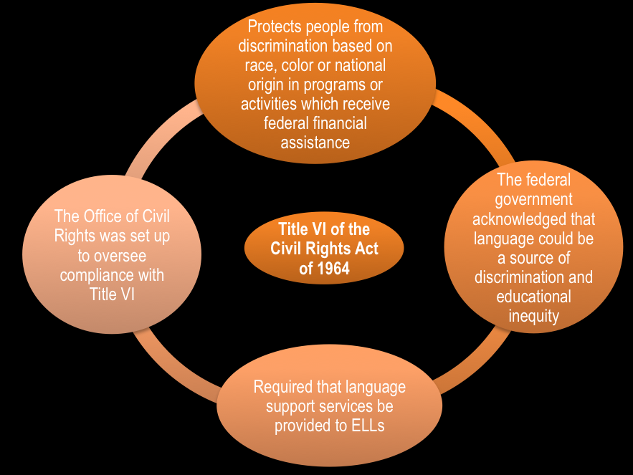
Purpose of Title VI
To eliminate discrimination in federally funded programs and activities.
To ensure equitable distribution of public funds for public benefit.

Slide 5
Title VI-Background
Discrimination
An action or inaction, whether intentional or unintentional, through which a person in the United States is subject to inequities because of their race, color, national origin, sex, age or disability.
Executive Order 11246 Amended to add gender identity and sexual orientation.

Slide 6
Types of Discrimination
Denial of Program Service, Financial Aid, or benefits
Providing different types of Program Services, Financial Aid
Segregating or separately treating individuals or groups in any matter relating to the receipt of any program service, financial aid, or benefit
Imposing impacts to groups for the benefit of another group
Restricting in any way the enjoyment of any advantage or privilege enjoyed by other receiving any program service, financial aid, or other benefits
Denying person(s) the opportunity to participate as a member of a planning, advisory or similar body
Denying person(s) the opportunity to participate in the program through the provision of services, or affording the opportunity to do so differently from those afforded to others.

Slide 7
YOUR NONDISCRIMINATION STATEMENT OF POLICY
The Your City/County values each individual’s civil rights and wishes to provide equal opportunity and equitable service for the citizens of this community. As a recipient of federal funds, the Your City/County is required to conform to Title VI of the Civil Rights Act of 1964 (Title VI) and all related statutes, regulations, and directives, which provide that no person shall be excluded from participation in, denied benefits of, or subjected to discrimination under any program or activity receiving federal financial assistance from the U.S. Department of Transportation (DOT) on the grounds of race, color, national origin, disability, religion, sex, sexual orientation, gender identity, age, low income status, or limited English proficiency.

Slide 8
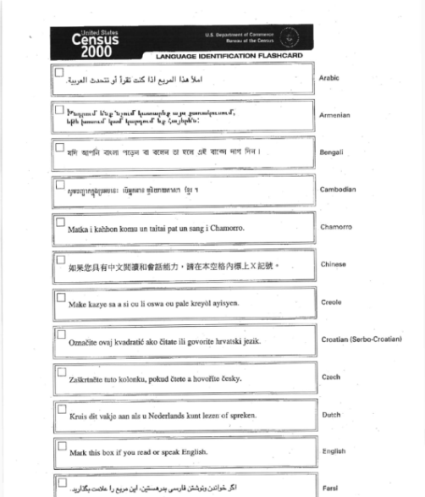
Limited English Proficiency (LEP)
Every department has access to language identification cards.
If a department frequently comes into contact with LEP persons they may need to consider providing a translator to help with the language barriers.
LEP
Executive Order 13133 requires federal-aid recipients to take reasonable steps to ensure meaningful access to their services to Limited English Proficiency Persons
Analysis:
Frequency of contact with LEP persons (How often we encounter LEP at work)
Importance of program or service provided
Available resources .(If we do encounter LEP persons do we have any resources to help the language barrier?)

Slide 9
ENVIRONMENTAL JUSTICE (EJ)
Executive order 12898 requires all federal agencies to make Environmental Justice (EJ) part of their mission by identifying and addressing the effects of all programs, policies, and activities on minority and low-income populations
Requirements:
Make a meaningful effort to involve low income populations in the decision making process
Evaluate the nature, extent, and incidence of probable, favorable, and adverse human health or environmental impacts on protected populations.
Incorporate EJ considerations throughout the project development process

Slide 10
WHICH Your City/County EMPLOYEES ARE AFFECTED BY TITLE VI COMPLIANCE?
EVERYONE!!!
As a recipient of federal funds, the Your City/County and it’s employees are required to be compliant in all services provided regardless if that service is funded by federal funds or not.
Without Title VI compliance, the city could be denied millions of federal funded dollars.

Slide 11
TITLE VI COMPLAINTS
If you receive a complaint that falls under Title VI:
Immediately inform a supervisor. That supervisor will inform the Title VI liaison(which for most departments will be the department head)in the department to further deal with the matter
Refer the citizen to the Title VI Coordinator for further information.
NAME - Title VI Coordinator
E-Mail: XXXXXXXX@XXXXX
Phone: 260-555-6362

Slide 12
RESOURCES
http://www.in.gov/indot/2751.htm

